Slide 1
Introduction to CSS
Dominic Ling
10 May 2014

Slide 2



What is CSS
Cascading Style Sheets
Contains the rules for the presentation of HTML.
+ =
HTML CSS Web Page
CSS was introduced to keep the presentation information separate from HTML markup (content).

Slide 3
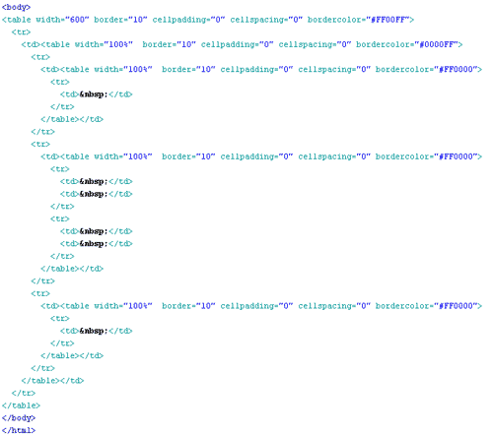
Before CSS
Initially Designers used presentation tags like (FONT, B, BR, TABLE etc.) and spacers GIFs to control the design of web pages.

Slide 4

Any modification in the design of websites was a very difficult and boring task , as it evolves manually editing every HTML page.

Slide 5
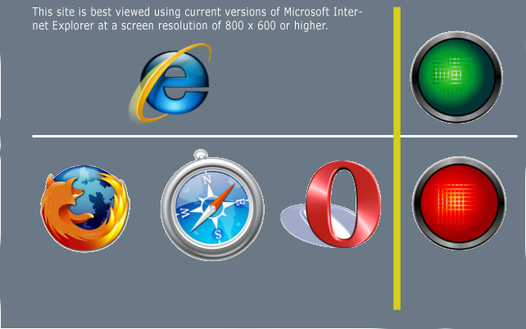
Providing support for multiple browsers was a difficult task.

Slide 6
Sources of Styles
Author (developer) Styles
Inline Styles - As inline attribute “style” inside HTML tags
<div style=“font-weight: bold;”>I am bold</div>
Embedded Styles - As embedded style tag with in HTML document.
  <html>
  <head>
      <title>Welcome to Vendio!</title>
      <style>
      .footer {
      width:90%;
      }
      </style>
      -------
  </html>
Linked Styles - Inside separate files with .css extension
<link rel="stylesheet" href=“external.css" type="text/css" />

Slide 7
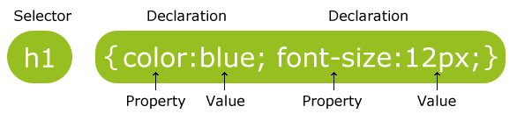
CSS Syntax
A CSS rule set consists of a selector and a declaration block:
Example - A CSS declaration always ends with a semicolon, and declaration groups are surrounded by curly brackets:
p {color:red;text-align:center;}
Notes:
The selector points to the HTML element you want to style.
The declaration block contains one or more declarations separated by semicolons.
Each declaration includes a property name and a value, separated by a colon.

Slide 8
CSS Selectors
ID based ( #)
HTML CSS
<div id=“content”> #content {
Text width: 200px;
</div> }
ID selectors should be used with single elements.

Slide 9
Class based selector
Class (.)
HTML CSS
<div class=“big”> .big{
Text width: 200px;
</div> }
<div>
<span class=“big”>some text </span>
</div>
Class based styles can be used by multiple HTML elements.

Slide 10
Tag based selectors
Tag (Tag name)
HTML CSS
<div> DIV {
Text width: 200px;
</div> }
<div> SPAN {
<span>some text </span> font-size:130%;
</div> }
<span>some other text </span>

Slide 11
Grouping
Multiple selectors can be grouped in a single style declaration by using , .
  H1, P , .main {
  font-weight:bold;
  }

Slide 12
Descendant selectors
Descendant selectors are used to select elements that are descendants (not necessarily children) of another element in the document tree.
HTML CSS
<div class=“abc”> DIV.abc P {
<div> font-weight:bold;
<P> }
Hello there! </p>
</div>
</div>

Slide 13
CSS Pseudo-classes
selector:pseudo-class { property: value }
:link
:visited } Link (A tag) related pseudo classes
:hover
:active
:after
:before
:first-child
:focus
:first-letter
:first-line
:lang

Slide 14
CSS Values
Words: text-align:center;.
Numerical values: Numerical values are usually followed by a unit type.
font-size:12px;
12 is the numerical value and px is the unit type pixels.
  Absolute Values – in, pc, px, cm, mm, pt
  Relative Values – em, ex, %
Color values: color:#336699 or color#369 or rgb(255, 255, 255).

Slide 15
Categories of CSS properties
Positioning and layout handling related.
Background related properties.
Font and text related
Links related.
Lists related.
Table related.

Slide 16

Cascade
The CSS cascade assigns a weight to each style rule. When several rules apply, the one with the greatest weight takes precedence.
Order of preference for various styles:
  Default browser style sheet (weakest)
  User style sheet
  Author style sheet
  Author embedded styles
  Author inline styles (strongest)

Slide 17
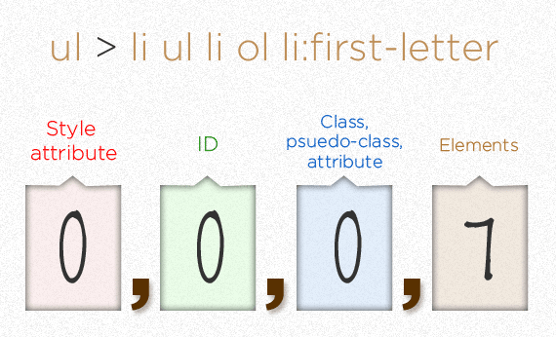
CSS Specificity
Rule 1. CSS File >> Embedded >> Inline
Rule 2. TAG >> class >> ID

Slide 18
Inheritance
Styles that relate to text and appearance are inherited by the descendant elements.
Styles that relate to the appearance of boxes created by styling DIVs, paragraphs, and other elements, such as borders, padding, margins are not inherited.

Slide 19
TEXT FORMATTING

Slide 20
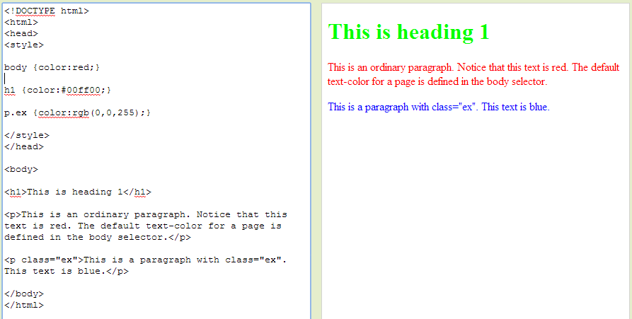
Text Color

Slide 21
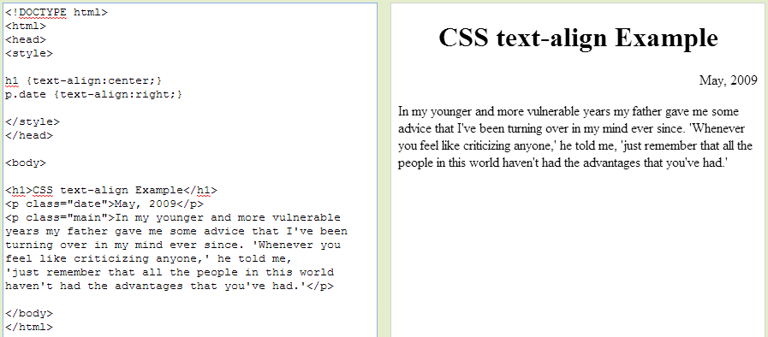
Text Alignment

Slide 22
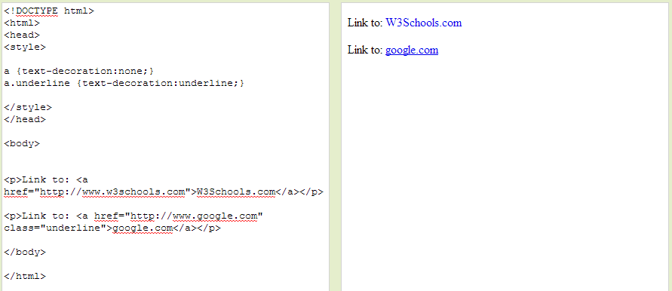
Text Decoration

Slide 23
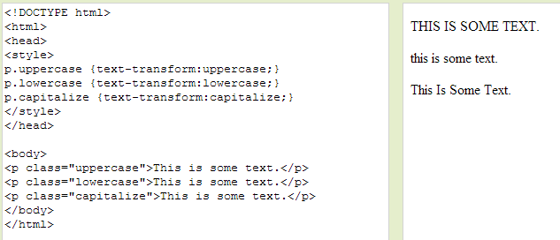
Text Transformation

Slide 24
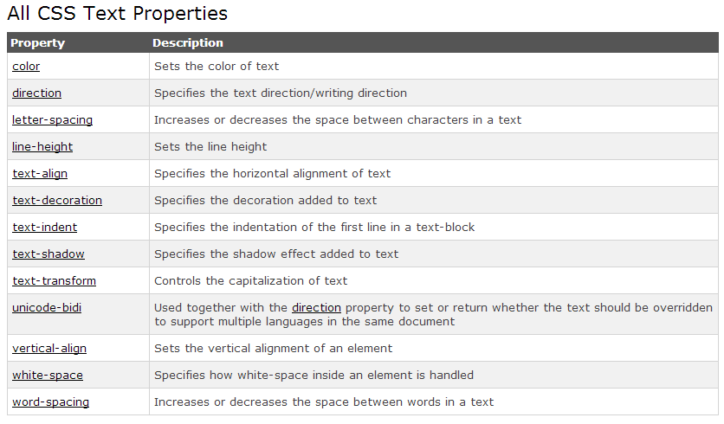
and more…
http://www.w3schools.com/css/css_text.asp

Slide 25
CSS Fonts

Slide 26
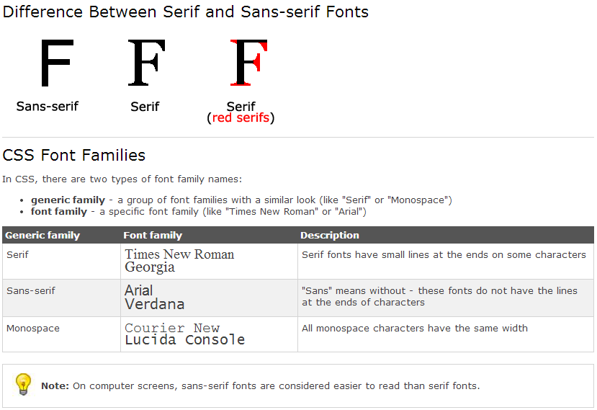
Font Family

Slide 27
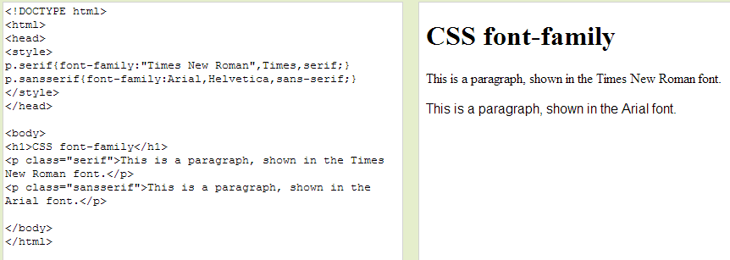
Font Family

Slide 28
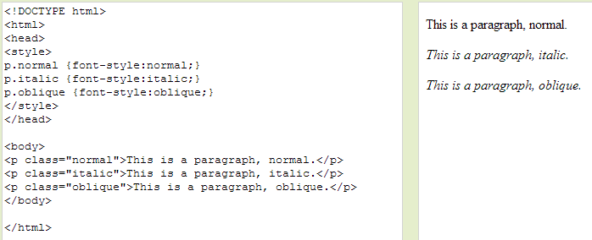
Font Style

Slide 29
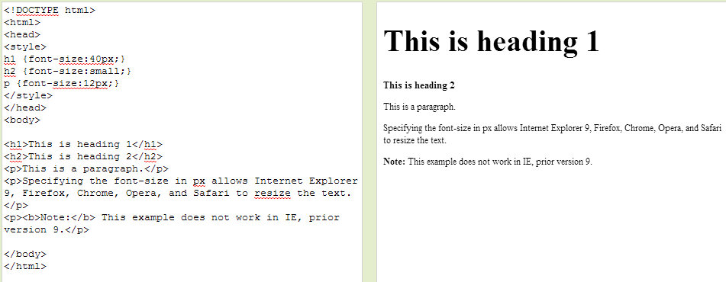
Font Size

Slide 30
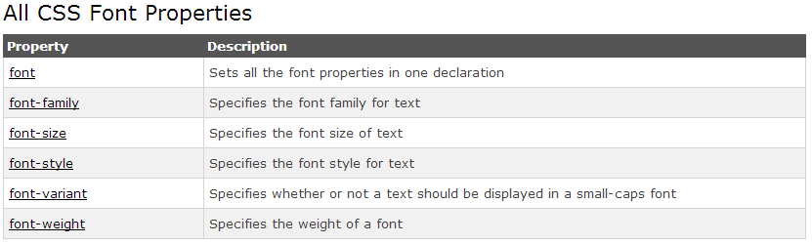
and more…
http://www.w3schools.com/css/css_font.asp

Slide 31


Slide 32


Slide 33
References
www.w3schools.com
www.w3.org
World wide web
Amit Tyagi – Introduction to CSS

Slide 34

Exercise

